Slide 1
BRIGHT TV ANALYSIS
BY
Tshiphiri Hangwani

Slide 2
AGENDA
ANALYSIS PROJECTION
CONSUMPTION TRENDS
OBJECTIVE
RECOMMENDATION

Slide 3
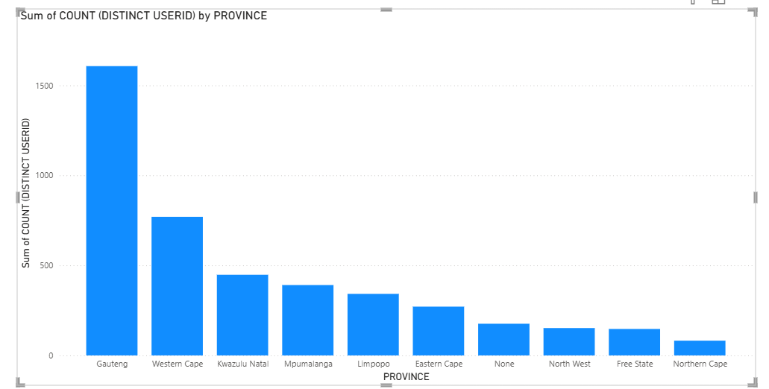
VIEWERSHIP BY PROVINCE
Gauteng is the province with most views with 37%
Western cape at 2nd position 17,5%
Northern cape at last position at 1,9%

Slide 4
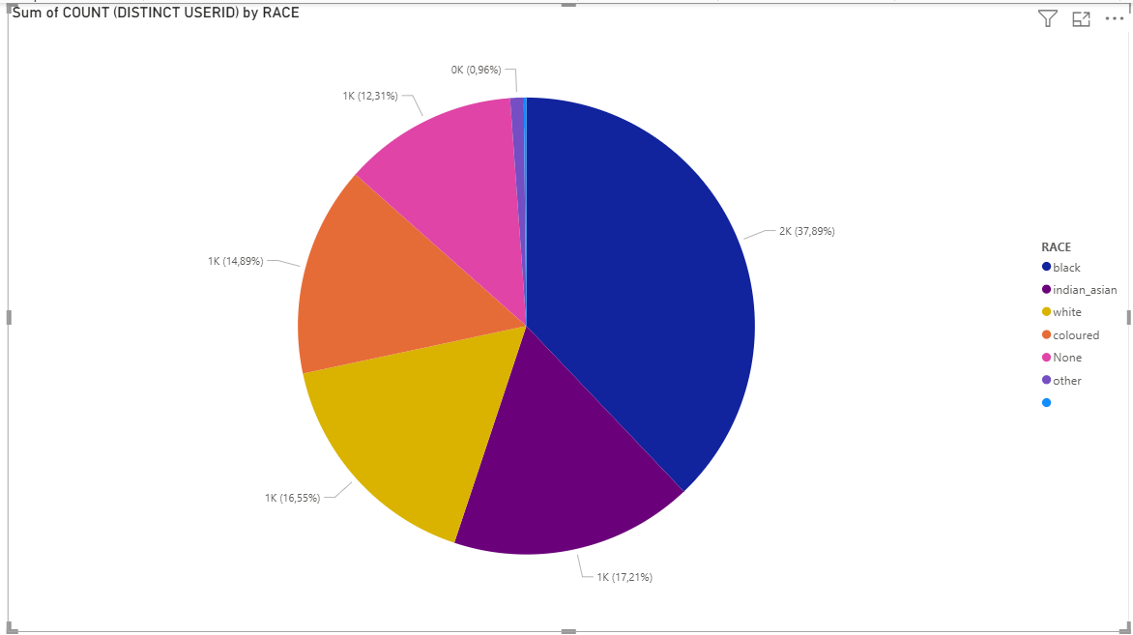
VIEWERSHIP BY RACE
0,96% is from others
12,31% views is from None
Black
37,89% views is from Blacks
14,89 views is from Coloured
16,55% views is from White
17,21% views is from Indians

Slide 5
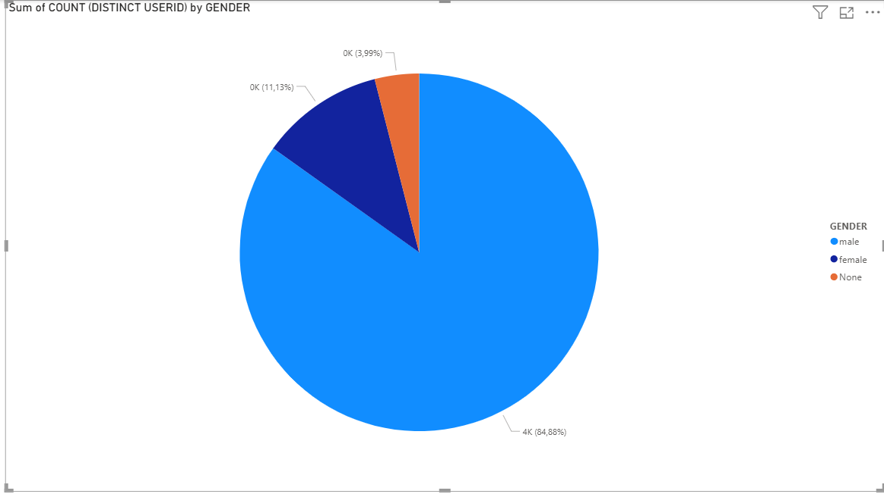
VIEWERSHIP BY GENDER
MALE HAS THE MOST VIEWERSHIP at 84% as compared to Female

Slide 6
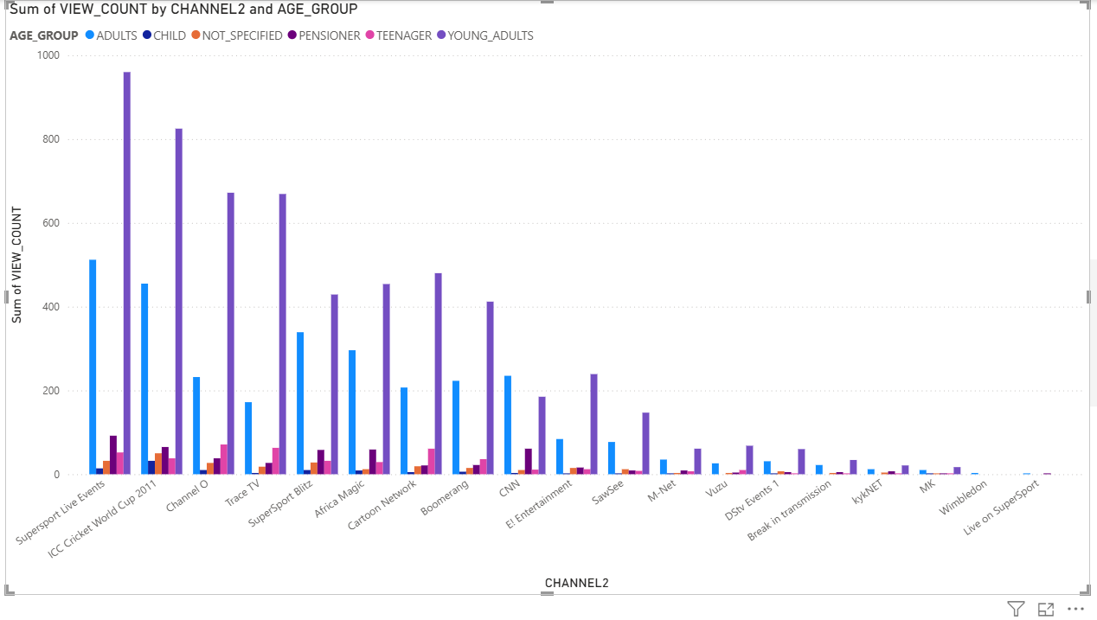

Slide 7
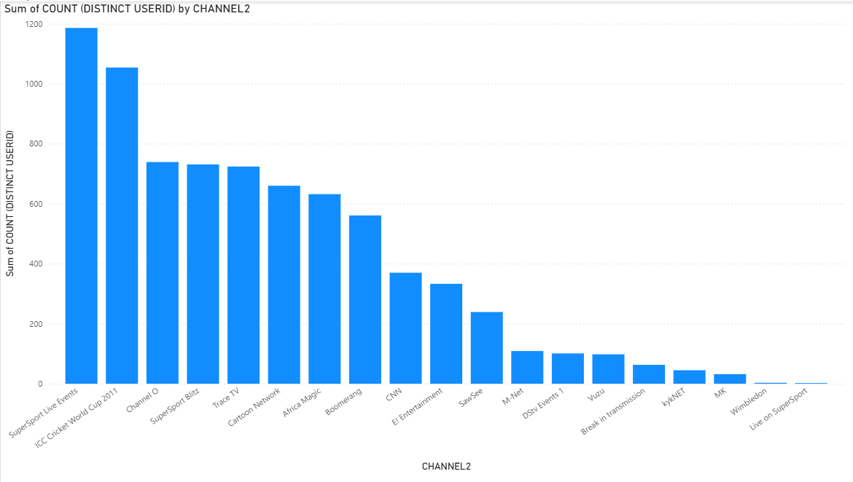

Slide 8
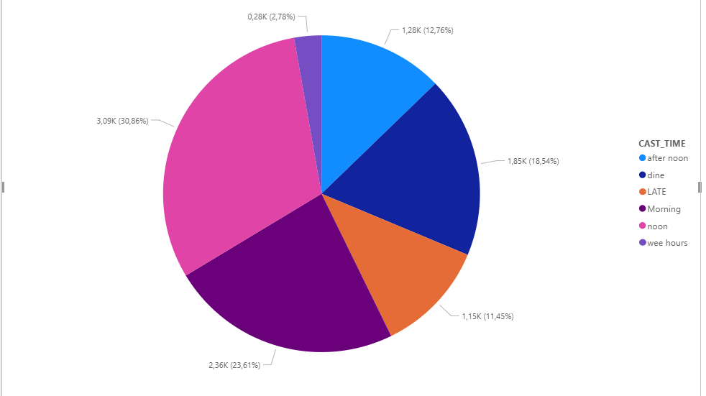
Time with most views
Notes:
Time with most viewership at
(10:00-13:59) at 30.86%

Slide 9
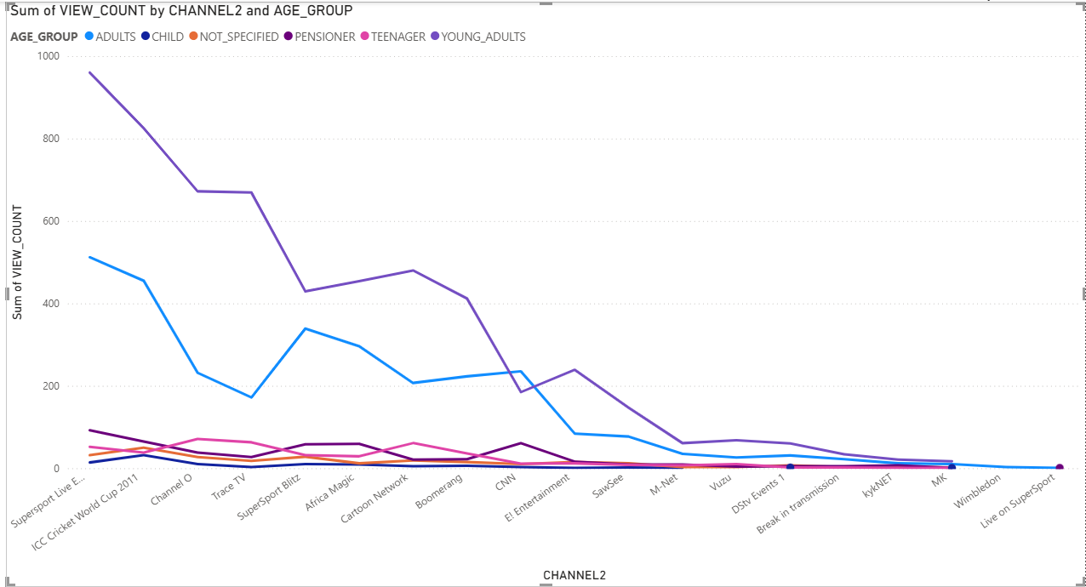
Viewership by channel and age group
Notes:
The most watched channel is Super sport live and its watched most by young adults(aged between 20-23)
The reason for this is most young adults have a online subscription that they can view TV anywhere at anytime.

Slide 10
Factors influence consumption
Consumption is high in Gauteng due to high population density
Super sport is the most watched channel due to Males being interested in sport as compared to female
TV is most watched noon (between '12:00:00' AND TIME '16:59:59’)

Slide 11
Initiatives recommended to further grow Bright TV
Initiatives recommended to further grow Bright TV
• Monetize live shows and events via digital platform
• check targeted adverts to increase revenue
• Increase subscription base channels and subscription platforms
• Increase advertising during sport time

